Slide 1
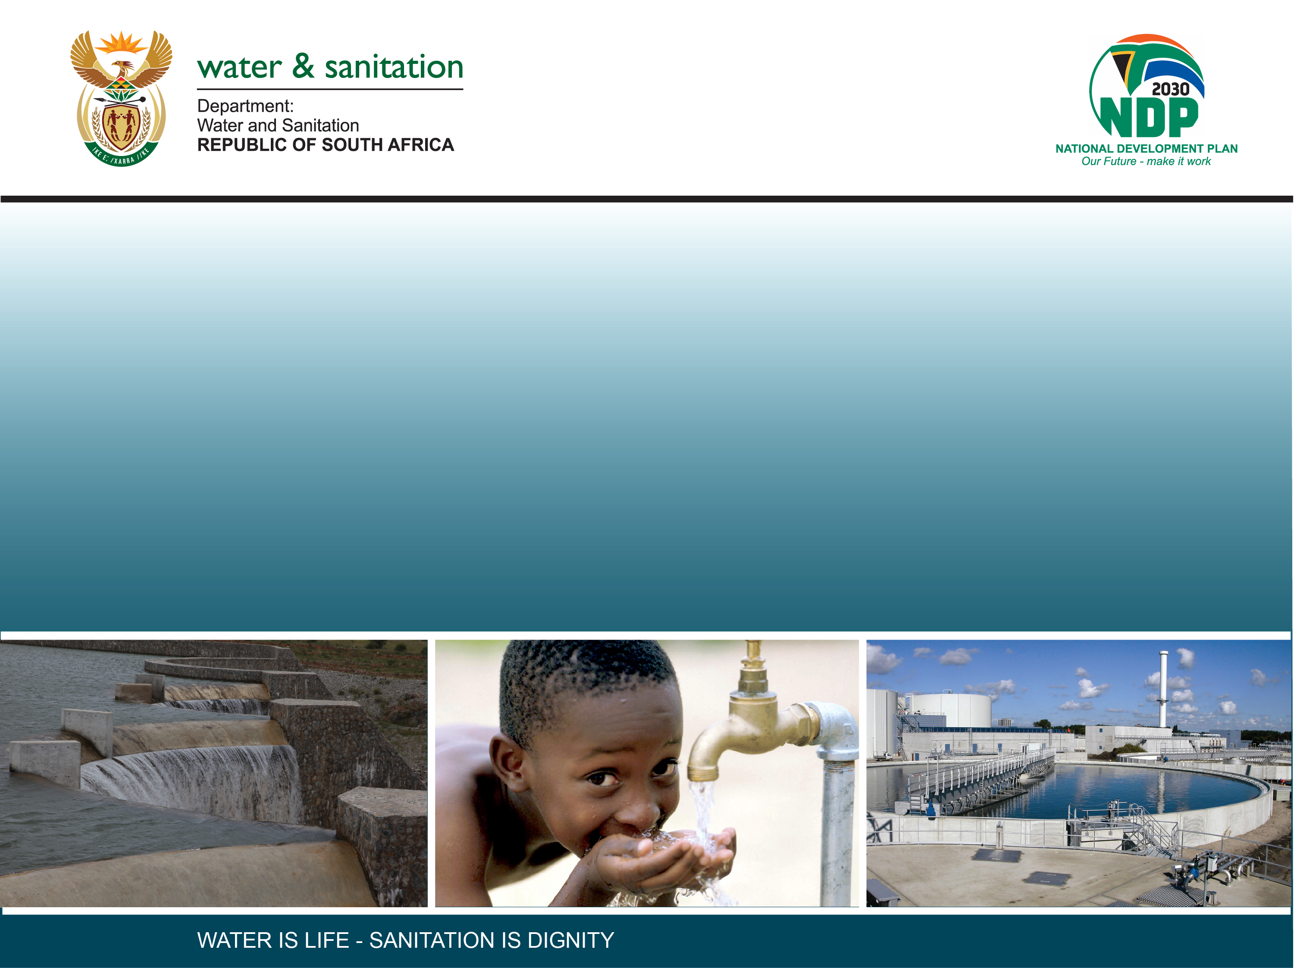
CLASSIFICATION OF SIGNIFICANT WATER RESOURCES AND DETERMINATION OF RESOURCE QUALITY OBJECTIVES FOR WATER RESOURCES IN THE USUTU TO MHLATHUZE CATCHMENTS (WP11387)
8.6 USER WATER QUALITY CONSEQUENCES

Slide 2
Non-ecological / User water quality Consequences
Patsy Scherman

Slide 3
PROCESS: STEPS 5 (Scenarios) AND 6 (RQOs)
Water quality = two broad components
  Ecological, i.e. as part of the EWR process. Output = EcoSpecs.
  Non-ecological or Users, i.e. UserSpecs (excl. aquatic ecosystems + includes users such as irrigation, stock-watering, domestic, recreation and industrial).
Now need to:
  ID wq role players, including non-ecological e.g. irrigation, settlements
  Start identifying indicators linked to driving variables associated with indicator wq role players, e.g. elevated phosphate associated with nutrients linked to stock-watering
  Eventually identify pollution priority areas and / or priority protection areas

Slide 4
Identify water quality priority RUs and water quality hotspots (desktop)
Step 1
Step 2
Identify priority wq role players + link them to the identified RUs. Use EWR info for aquatic ecosystems.
Step 3
Identify driving water quality variables
Step 4
Gather info from Technical Task Group
Determine consequences on driving variables
Identify range of scenarios + RUs impacted on
Step 5
Select optimal scenarios, select Water Resource Classes + associated catchment configurations, and PREPARE RQOs
Rank scenarios
Step 6

Slide 5
METHODOLOGY
Set WQ requirements for non-ecological water quality users
  The significant step here is to (1) link the condition of the resource to user water quality targets (e.g. as per industrial or agricultural water quality guidelines), and (2) determine or confirm water quality requirements for identified priority user driving variables.
Assess changes in water quality state under scenarios
  The change in water quality state has to be determined under each scenario for impacted areas or users.
Determine consequences by linking expected changes in water quality state to requirements of priority driving variables
Changes in water quality state under each scenario will be linked to changes in driving variables resulting in the changed overall state. These changes are evaluated against the requirements of identified users or role players.

Slide 6
METHODOLOGY
Methods outlined in the 2016 DWS document on operationalising Resource Directed Measures.
The assessment is linked specifically to river EWR sites, so High Priority river stretches potentially impacted by operational river scenarios.
All eight EWR sites are affected by the supplied river operational scenarios, but ecological consequences minimal. User wq normally closely follows ecological consequences as ecology = most sensitive user.
Information required:
  Status Quo (an example of map shown in next slide)
  Outputs from TTG meeting, 2 November 2022, and subsequent meetings/interactions
  Outputs of scenario assessment from WRC-DSS.
xxxx

Slide 7
W1 (Mhlathuze): Water quality status quo
W12C-03263 (Mfulazane). Large impact. Melmoth Ponds.
W12E-03475 (Mhlatuze). Large impact. Dryland cultivation; high turbidities.
W12H-03401 (Okula). Large impact. Dryland cultivation; Fairbreeze.
W12H-03289 (Mbabe). Large impact. Nseleni WWTW.
W12J-03392 (Mpisini). Large impact. RBM smelter.
W11A-03612 (Matigulu). Lower reach only: Large impact. Sugar Mill; cultivation; sand-mining
Mhlatuze Est: Very High PP – agriculture
Richards Bay lakes: High PP – port-based activities
W12F-03494 (Mhlatuze). Large impact. Tongaat Mill; Mpact; urban impacts.
Siyaya Est: Very High PP – agriculture
W12F-03611 (Mzingwenya). Large impact. Impacts from large settlements.
Notes:
Caryn to do the scope, will be Tasks of study, deliverables, reference to previous ewr study, use some of following slides, but simplify

Slide 8
CONSEQUENCES ON WATER QUALITY PER SCENARIO AND PER RELEVANT RU AND IUA ARE SCORED USING THE DRIVING WATER QUALITY VARIABLES LINKED TO THE PRIMARY WATER QUALITY ROLE PLAYERS. NOTE THAT ALTHOUGH THE AQUATIC ECOSYSTEM IS THE RESOURCE BASE RATHER THAN A “USER”, IT IS GROUPED AND EVALUATED WITH OTHER USERS FOR PURPOSES OF THIS STEP OF THE CLASSIFICATION PROCESS.

Slide 9
RESULTS: Scenarios
    Ecology is the main “user” at stretches containing EWR sites. Remember Chapter 3, NWA:
    Information on other users was “checked” at these river stretches.
    Climate change scenario: some impact expected; impact on ecology most significant.
    Other scenarios had no impact on driving users, and no implications on Userspecs expected.
SUSTAINABLE UTILISATION = LONG-TERM BALANCE BETWEEN USE AND PROTECTION OF WATER RESOURCES

